Slide 1



Project Report
SOFTWARE ARCHITECTURE
Topic: Building a Web-Based Library Management System
Group : Group 1
Students : Nguyễn Đăng Hiếu - 23010049
Nguyễn Trường Sơn - 23010313
Đỗ Hữu Đại – 23010825
Bùi Đắc Hợp - 23012022
Instructor : Vũ Quang Dũng
Class : Software Architecture(N01)

Slide 2
Contents
I. Introduction
II. Requirements
III. Conclusion

Slide 3

I. Introduction
1. Project Introduction
Topic: Building a Web-Based Library Management System
Technology: Django (Python), MySQL, HTML/CSS/JS, Tailwind, Cloudinary,.....
Scope :Manage book information, users, borrowing and returning, and searching.
2. Objectives and significance
Automating library operations reduces errors associated with manual management.
Helps learners develop skills in software analysis, design, and programming.
Contributes to the digitalization of management in the education sector.
3. Development method – Agile model
Iterative development, flexible to changing requirements
Enhanced téting, rapdi feedback.
Promotes effective teamwork

Slide 4

II. Requirements
1. Functional Requirements
2. Non-funtional Requirements
User management: registration, login, permission assignment (Librarian, Reader).
Book management: add, edit, delete, search, view details.
Borrowing and returning: record borrowing/returning,renewal, track book status.
Statistics: number of borrowings, genres, user violations. Book reviews: user comments and reviews.
Performance: Page load time < 2 seconds, 20–30 simultaneous users.
Security: Clear access control, password encryption.
Usability: User-friendly interface, fast operation.
Scaleability: Add new modules, flexible database

Slide 5
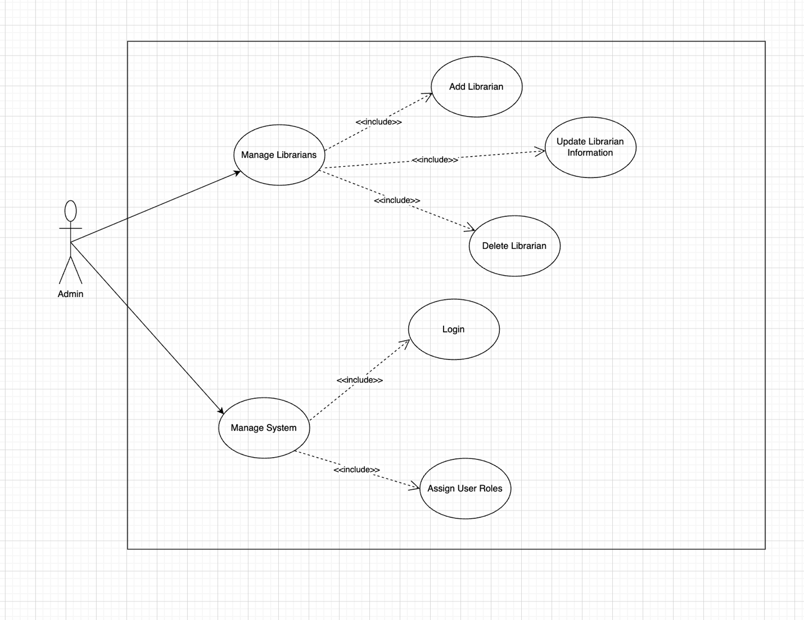
3, Use case diagram
Admin ↔ (View statistical reports, manage librarians, manage systems.)

Slide 6
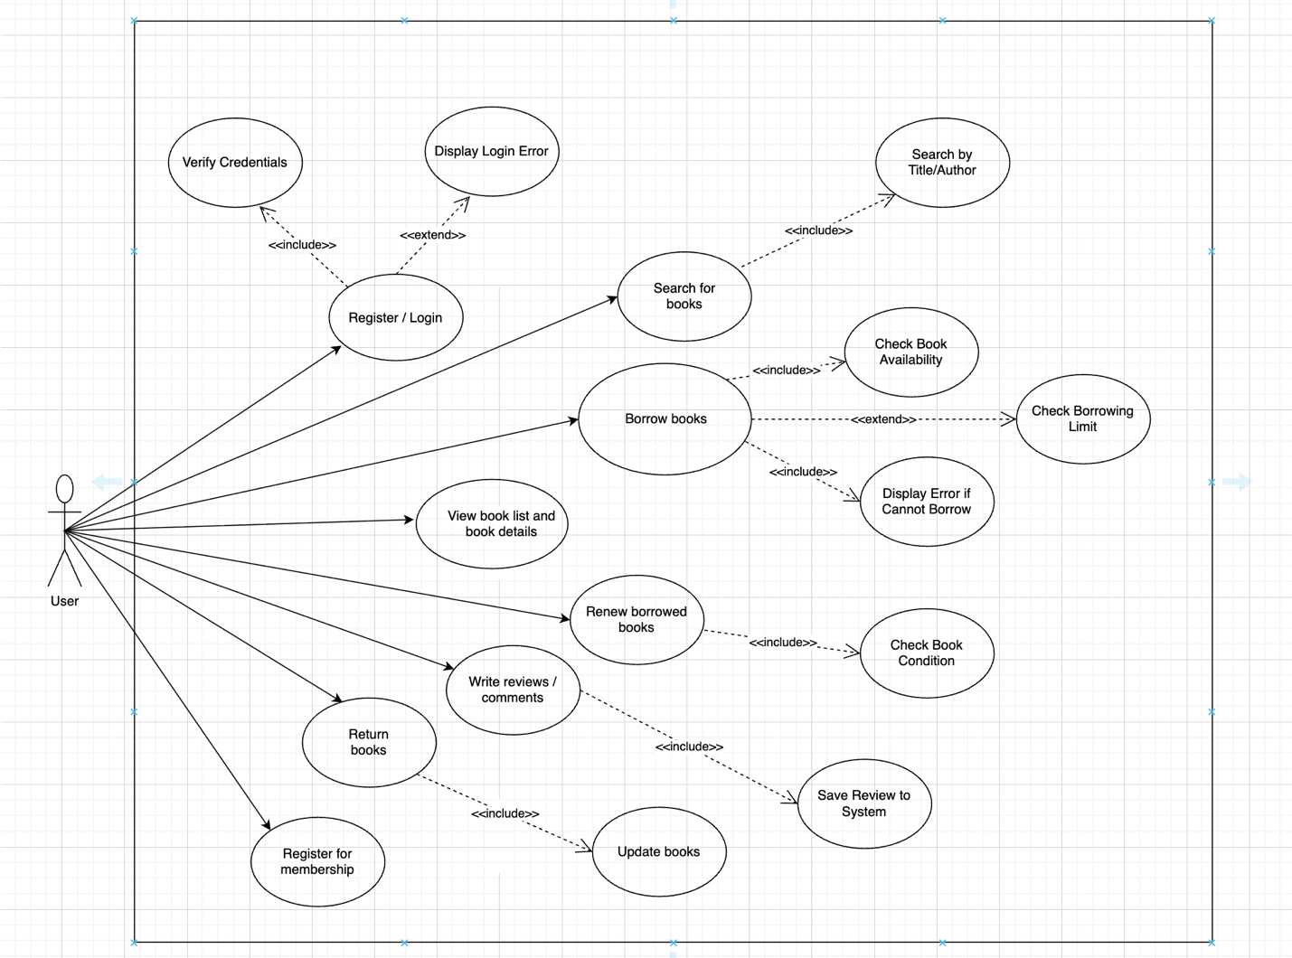
3. Use case diagram
User ↔ (Register/Log in, Search for books, View details, Borrow, Return, Renew, Review, Register as a member )

Slide 7
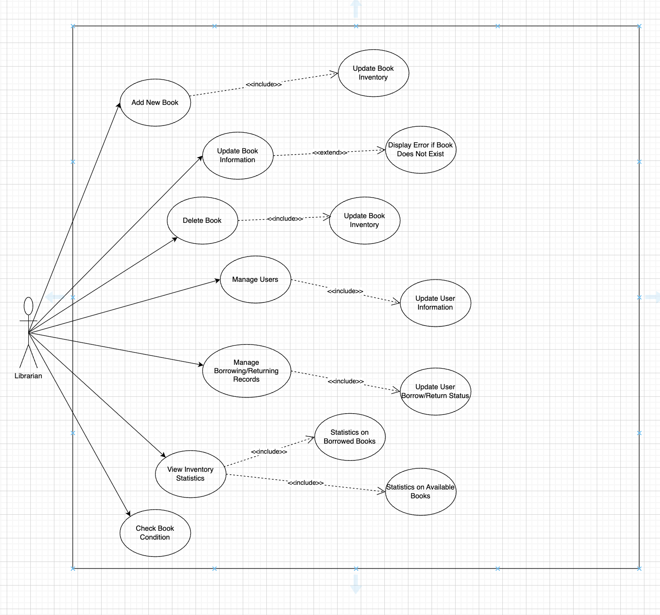
3. Use case diagram
Librarian ↔ (Book management, User management, Borrowing and returning management, Check book status, view statistics, E-book management)

Slide 8
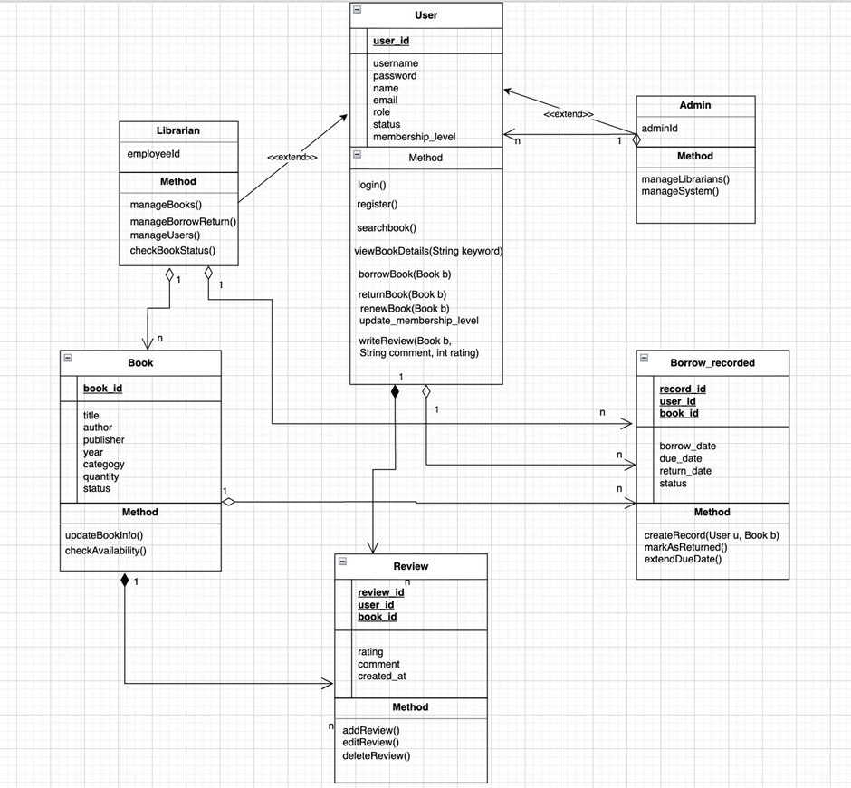
4. Data diagram

Slide 9
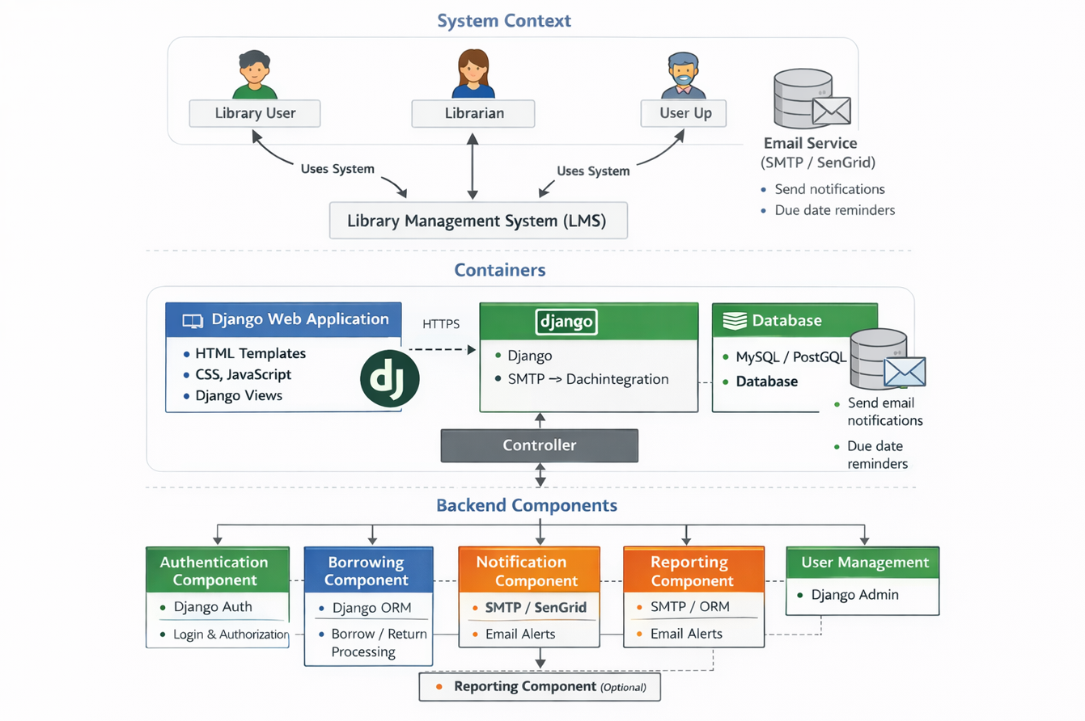
5. C4 Model

Slide 10
III. Conclusion
1. Things that have been accomplished
Complete core functions: book management, borrowing/returning, and user management.
User-friendly interface with map and online reading.
Stable system with basic access control.
2. Project limitations
3. Development direction
No visual statistics available.
Permission management is still simple.
Not yet implemented online (currently running locally).).
Add statistical charts and AI-powered book suggestions.
Integrate online payment/penalty processing.
Develop a mobile application.
Move the system to the Cloud for real-world use.

Slide 11
THANK YOU

